Slide 1
The Future of Democracy and Human Rights in Iran
Location: Southern Methodist University, Time: 3:00 p.m
Participants: Ali Reza Nourizadeh, Mojtaba Vahedi, Oscar Morales, Aliakbar Moussavi Khoeni
Moderated by: Mora Namdar - Editor-in-Chief, National Security Law Brief of American University Washington College of Law
Sponsored by: SMU Amnesty International and SMU Embry Human Rights Department
NATIONAL SECURITY LAW BRIEF
AMERICAN UNIVERSITY
WASHINGTON COLLEGE OF LAW

Slide 2
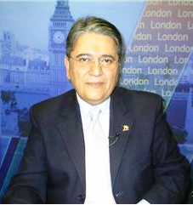
Dr. Ali Reza Nourizadeh
The world renowned Iranian journalist
Senior commentator for Voice of America
Columnist for London Kayhan
Director of the Centre for Iranian & Arab Studies
Senior writer in Al-Sharqal Awsat Arabic daily news paper
Editor in chief of Al-Moujez monthly News letter in Arabic
Former editor of Etela'att
Former editor in chief of Weekly magazine Omid Iran

Slide 3
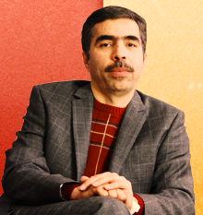
Mr. Mojataba Vahedi
Chief advisor to Mr. Kahrobi’s 2005 & 2009 election
Chief advisor to Mr. Kahrobi as speaker of the house (Majlis) in 2000
Former editor in chief of Aftabe Yazd which endorsed both reformist candidates (Mr. Mousavi and Mr. Karroubi) and criticized Ahmadinejad
Author of several of Mr. Karroubi’s letters including a well-known protest to Mr. Firouz-Abadi, the commander of the Armed Forces
Spokes person for Kahrobi

Slide 4
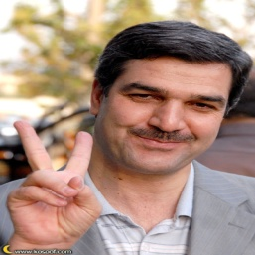
Ali Akbar Mousavi Khoeini
Notable Iranian human rights activist and politician
Current president of Advar Tahkim Vahdat
Elected as a Member of Parliament in the 6th Parliament of Iran working the defense of the rights of political prisoners during the 1990’s.
Founded Sazeman-e Danesh Amokhtegan-e Iran (Iran Students Alumni Organization) to defend human rights of students, women, prisoners, and minorities.
He was arrested in a protest on June 12, 2006 in Haft-e Tir Square in Tehran and was put in solitary confinement. He was released on bail on Oct 22, 2006.

Slide 5
Oscar Guevara Morales
First visiting fellow in the Human Freedom area of engagement at the George W. Bush Institute
Recently appointed the youngest Counselor of One Young World, an initiative supported by Kofi Annan, Archbishop Desmond Tutu, Sir Bob Geldof, Mohamed Yunus, and others.
Creator of the Facebook group "One Million Voices against FARC,“ led the WORLDWIDE MOBILIZATION AGAINST FARC that took place on February 4, 2008.
Cofounded the One Million Voices Foundation
In May 2009, Morales was a speaker at Google Zeitgeist 2009 in London
In September 2008, spoke at Facebook headquarters‘ invited by founder Mark Zuckerberg

